Slide 1
SafeLandUSA™ 2021

Slide 2
SafeLandUSA™ 2021
ETC’s SafeLandUSA™ 2021 is a one-day safety orientation accredited by SafeLand™ Inc. This orientation provides general safety information to the student and is designed to be used in conjunction with a company’s comprehensive health and safety program.
The SafeLandUSA™ name and logo are used with the approval of SafeLand™ Inc.

Slide 3
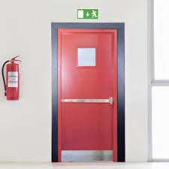
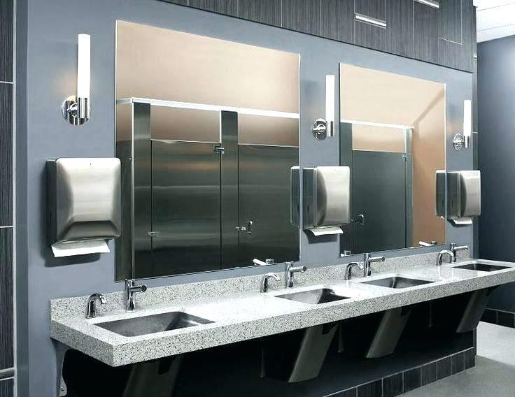
Housekeeping
Fire extinguishers and emergency exits
Restroom
locations
Breaks and lunch
Cell phone usage

Slide 4
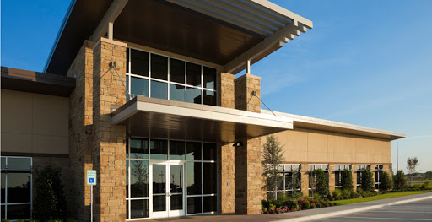
Housekeeping
Company or site-specific information
Introductions
Testing procedures and grading requirements

Slide 5
Life-Saving Rules Overview

Slide 6
Life-Saving Rules
9 Rules created by the International Association of Oil and Gas Producers (IOGP)
Life-Saving Rules (LSR) identify activities most likely to lead to serious injury and fatalities (SIFs)
LSRs provide oil and gas workers with life-saving actions which a worker has control over to protect themselves and co-workers

Slide 7
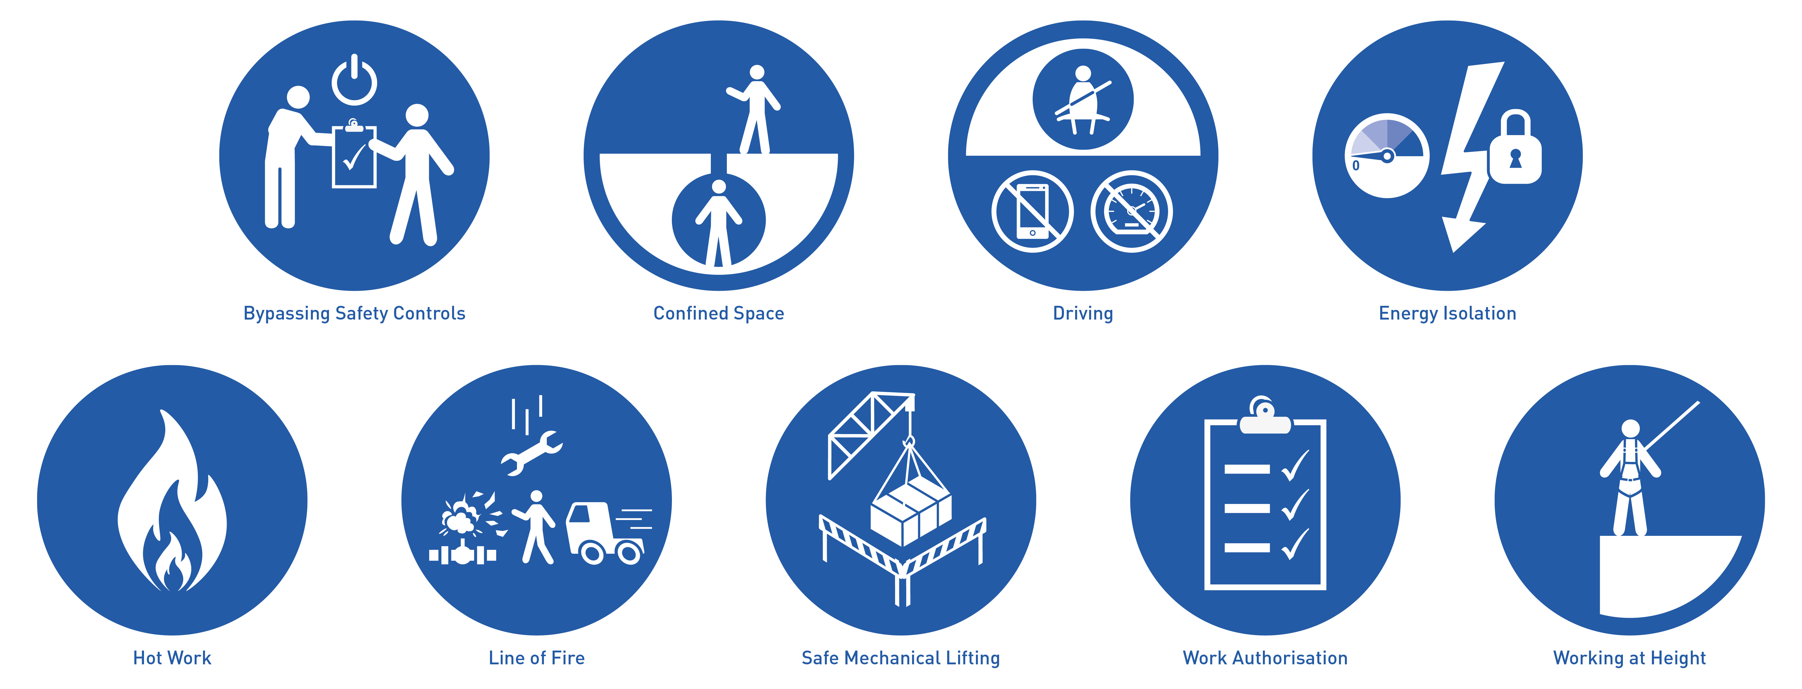
Life-Saving Rules
SafeLandUSA™ 2021

Slide 8
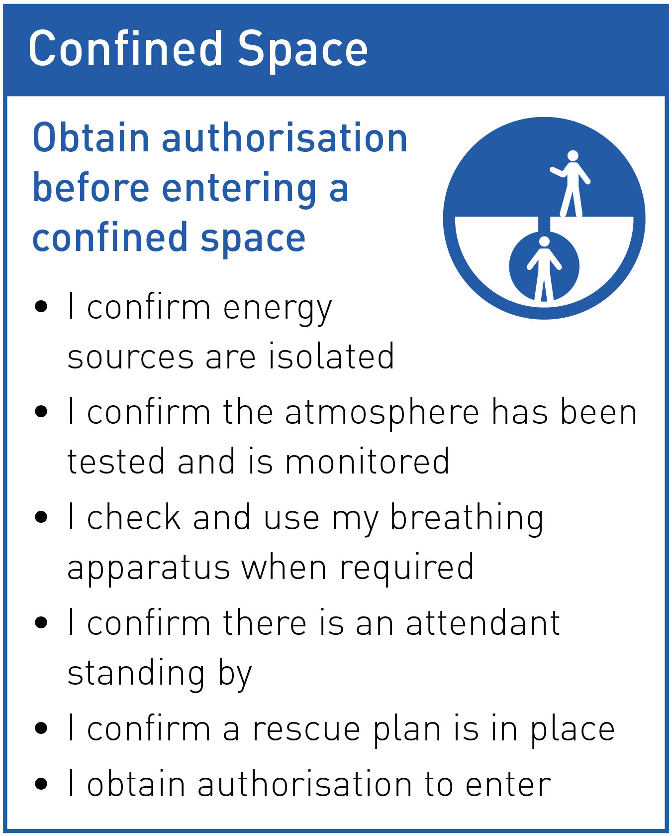
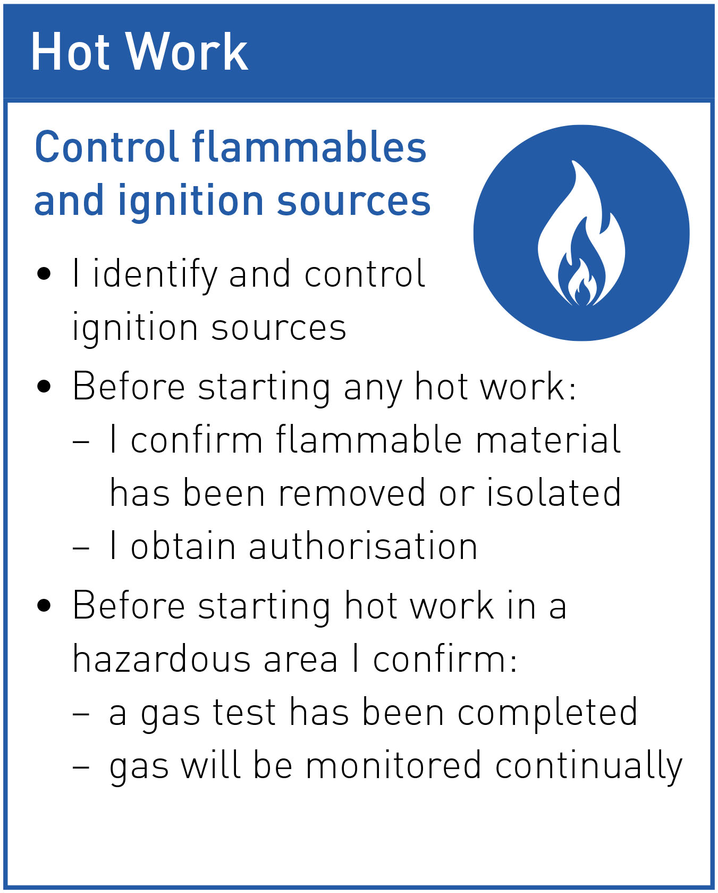
Life-Saving Rules
9 Life-Saving Rules
Rule statement
Actions
Bypassing Safety Controls
Confined Space
Driving
Energy Isolation
Hot Work
Line of Fire
Safe Mechanical Lifting
Work Authorisation
Working at Height

Slide 9
Life-Saving Rules
Applying the Rules
STOP
Toolbox talks & Safety meetings
Can we learn from incidents that involved a Life-Saving Rule not being followed?
Pre-job planning
Are we doing any work today involving a Life-Saving Rule?
How can we follow the Rule from start to finish?
What needs to be in place?
Is everything in place, and in good working condition?
Last minute risk assessment
Have I done all the Life-Saving Rules actions?
Is everything as we discussed in the pre-job planning?
Are there any Line of Fire hazards or ignition sources we didn’t identify?
Post-job reviews
Did we take all the actions associated with the Life-Saving Rules?
What went well? What didn’t go well?
Anything to note for the next time we have to this perform task or work in this area?
Observations & walkabouts
Do you see anyone performing work when a Life-Saving Rule is relevant?
Are they following the Rule?
Yes? Great, recognise it!
No? Intervene!
Intervention
Intervene or stop the work if a Life-Saving Rule is not being followed

Slide 10
Safety Culture
SafeLandUSA™ 2021

Slide 11
Safety Culture
Safety Culture
What does safety culture mean to you?

Slide 12
Safety Culture
Safety Culture
Objectives
Discuss your company’s safety culture
Discuss how behavior, human performance factors and culture help to reduce serious injury and fatality prevention
Discuss human performance tools that can help eliminate human errors

Slide 13
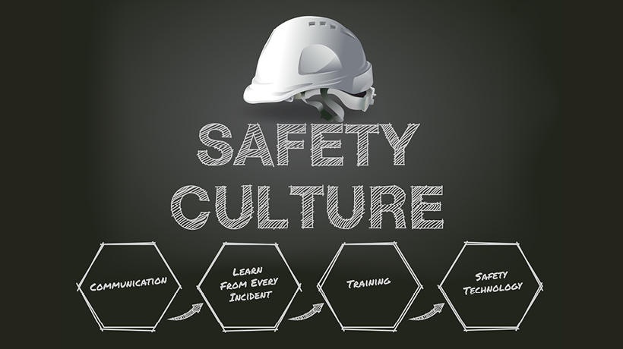
Safety Culture
Safety Culture
Safety Culture should be a core value within a company within every level. A culture is built on behavior based safety, SIFs, and human performance factors.
It’s more than complying with OSHA standards
Communication
Training
Auditing

Slide 14
Behavior Based Safety
Safety Culture
Two of the biggest influences on a company’s safety culture are worker behavior and human performance factors.
Behavior is how you act. Your behavior is a physical display of your emotions and your attitude.
If your emotions or your attitude are negative then your behavior is likely to be negative which can directly effect safety.

Slide 15
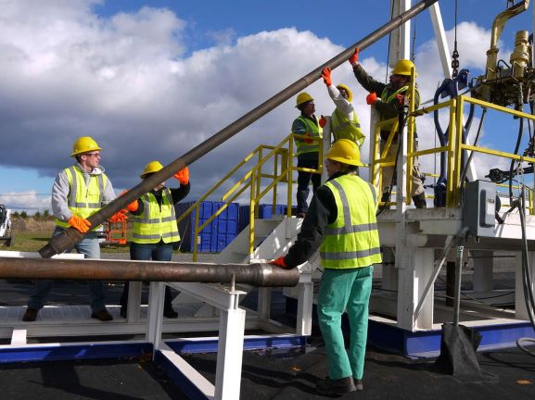
Behavior Based Safety
Safety Culture
Observations
Observations are a key component of a BBS program.
The observation process uses an observation card to collect data on worker attitude, behavior, and action.
Observations should also be done by workers to identify unsafe acts and conditions.

Slide 16
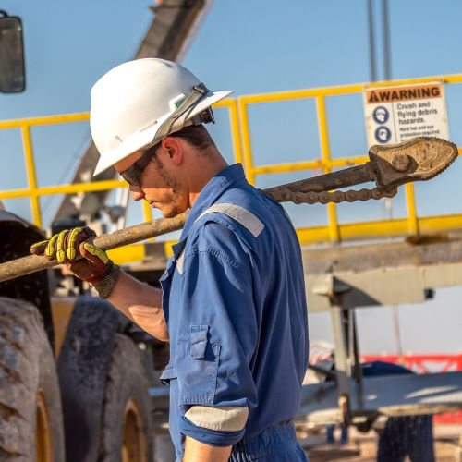
Human Performance
Safety Culture
Human Performance
Is the way people think about and do their work
Supports that behavior is an outcome of an improperly designed system, not the root cause of the problem.
Accepts workers will make mistakes

Slide 17
Human Performance Factors
Safety Culture
In the oil and gas industry, understanding human factors is an essential component in an effort to operate in a safe and efficient manner. Areas where human factors has a key role include
Design of tools, equipment, and usage
Risk assessments and emergency preparedness planning
Observation process
Teamwork and decision making in critical situations

Slide 18
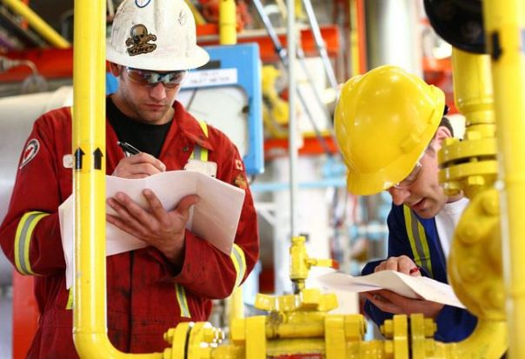
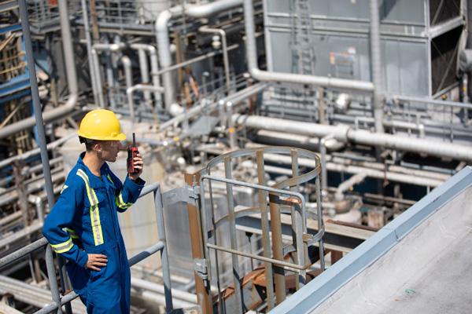
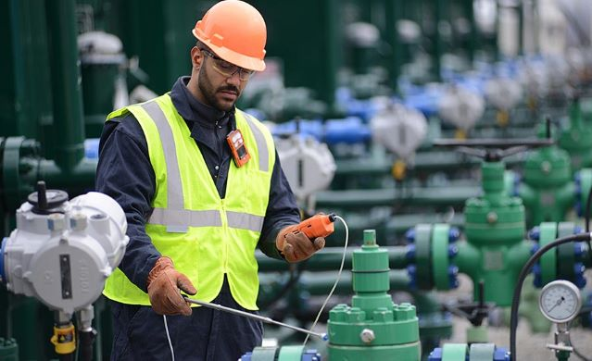
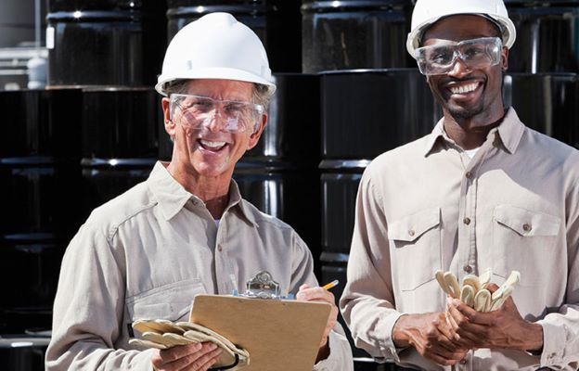
Human Performance
Safety Culture
Actions to help eliminate human errors include:
Self and Peer-checking
Three-way Communication
Procedure Use and Adherence
JSAs
Stopping When Uncertain
Questioning Attitude

Slide 19
Safety Culture
Safety Culture
To prevent SIFs we need to look at both BBS and human performance factors and how they each directly affect incidents in the workplace.
Human Performance
Bahavior-Based Safety
Preventing SIFs

Slide 20
Safety Culture
Safety Culture
Lesson Review
Discuss your company’s safety culture
Discuss how behavior, human performance factors and culture help to reduce serious injury and fatality prevention
Discuss human performance tools that can help eliminate human errors

Slide 21
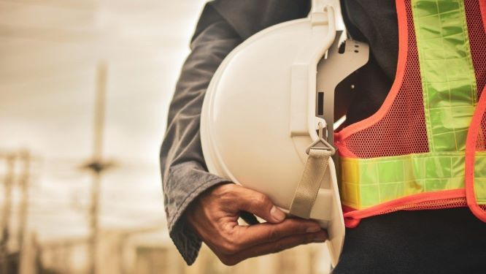
General Safety
SafeLandUSA™ 2021

Slide 22
General Safety
General Safety
What types of policies and programs are
needed to provide a safe workplace?

Slide 23
General Safety
General Safety
Objectives
Discuss a company’s general safety requirements
Discuss why incident reporting is important
Discuss how communication plays a vital role in keeping workers safe

Slide 24
General Safety
General Safety
Companies are required to implement policies and procedures that will provide a safe workplace. It is important to understand and adhere to these policies to help promote a safe work environment for you and your coworkers.

Slide 25
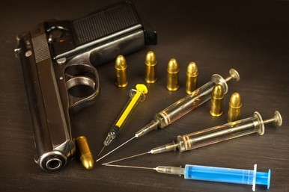
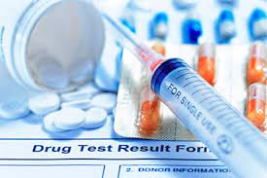
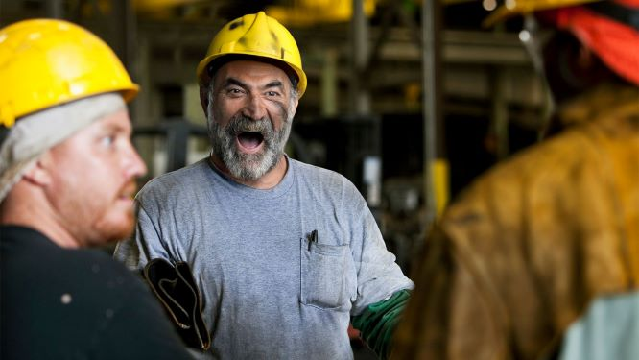
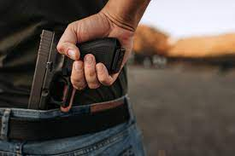
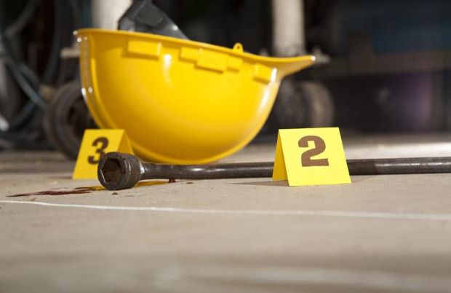
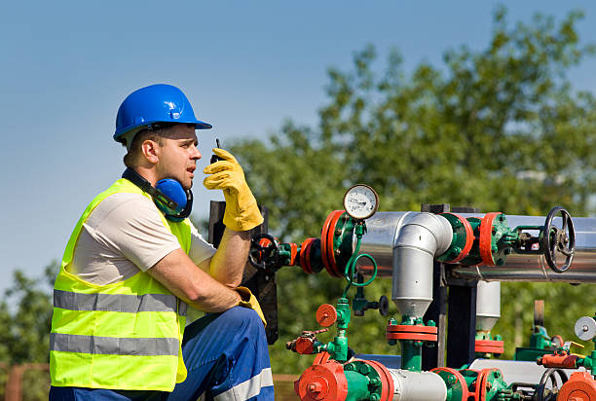
General Safety
General Safety
Contraband
Drug Testing
Workplace Violence
Incident Reporting, Investigation, and
Root Cause
Active shooter
Communication

Slide 26
General Safety
General Safety
Communication
One of the most effective ways to improve safety culture and prevent injuries is to optimize safety-related communication throughout an organization.
What are some barriers that can reduce your ability to communicate?
What can you do to overcome communication barriers?
What is three-way communication?

Slide 27
General Safety
General Safety
Lesson Review
Discuss a company’s general safety requirements
Discuss why incident reporting is important
Discuss how communication plays a vital role in keeping workers safe

Slide 28
Hazard Control
SafeLandUSA™ 2021

Slide 29
Hazard Control
Hazard Control
What hazards do you encounter in the
workplace?

Slide 30
Hazard Control
Hazard Control
Objectives
Discuss how the hierarchy of controls is used to prevent worker exposure to hazards
Discuss administrative controls that can limit worker exposure
Discuss how to complete a Job Safety Analysis (JSA)
Discuss the IOGP Work Authorisation Life-Saving Rule

Slide 31
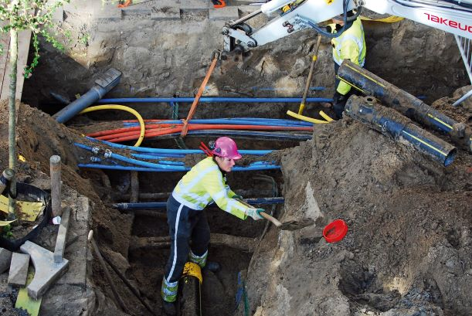
Hazard Control
Hazard Control
Can you identify
the hazards?

Slide 32
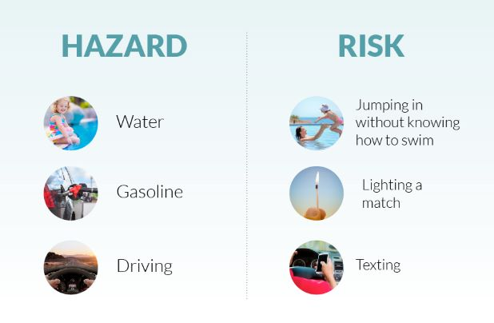
Hazards vs Risk
Hazard Control
A risk is the chance or probability that someone will be harmed or experience adverse health effects if exposed to a hazard. While hazards and risks are similar, risks require some form of action in order to take place and are the probability of harm occurring.

Slide 33
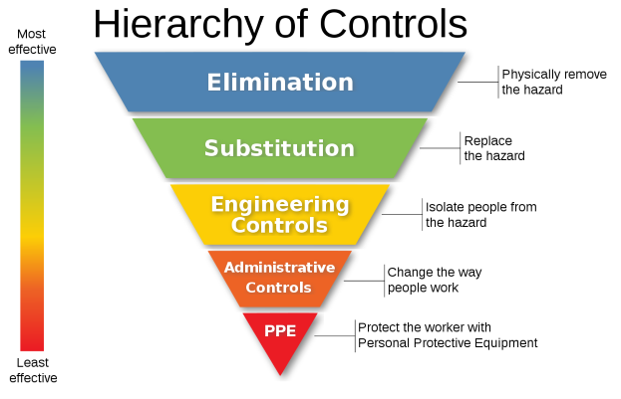
Hierarchy of Controls
Hazard Control

Slide 34
Engineering Controls
Hazard Control
Elimination and substitution controls are an ideal solution, but they aren’t always practical to implement. For this reason, engineering controls are considered the best method to control hazards.
Machine guarding
Ventilation
Sound-dampening materials to reduce noise levels
Use of mechanical lifting devices

Slide 35
Administrative Controls
Hazard Control
Administrative controls are used to improve safety within the workplace by putting policies and procedures in place that reduce the duration, frequency, and severity of exposure to hazards.
Interventions
& Stop Work
Fit-for-Duty Exams
Short Service Employees
JSA
Permits to work

Slide 36
Job Safety Analysis (JSA)
Hazard Control
What is a JSA?
When do you complete a JSA?
Who fills out a JSA?
How long does it take to review a JSA?

Slide 37
Work Authorisation
Hazard Control
Objectives
Discuss a company’s general safety requirements
Discuss why incident reporting is important
Discuss how communication plays a vital role in keeping workers safe

Slide 38
Work Authorisation
Hazard Control
A permit to work is an essential part of work authorization.
It identifies the following:
Type of work to be done
Hazards involved
Personnel authorized to perform the work
Control measures and precautions
What types of jobs require permitting?

Slide 39
Hazard Control
Hazard Control
Lesson Review
Discuss how the hierarchy of controls is used to prevent worker exposure to hazards
Discuss administrative controls that can limit worker exposure
Discuss how to complete a Job Safety Analysis (JSA)
Discuss the IOGP Work Authorisation Life-Saving Rule

Slide 40
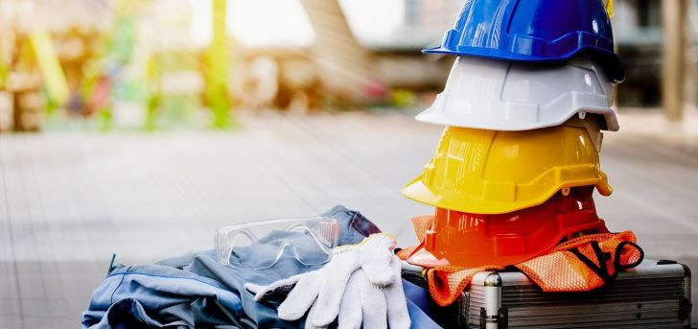
Personal Protective Equipment
SafeLandUSA™ 2021

Slide 41
Personal Protective Equipment
PPE
Objectives
Discuss company and worker responsibilities regarding PPE
Discuss reasons why workers do not wear PPE
Identify common types of PPE
Discuss maintenance and inspection of PPE

Slide 42
Personal Protective Equipment
PPE
Company and Worker Responsibilities
Companies are required to
Assess hazards in the workplace and identify and provide the necessary PPE
Conduct and document PPE training
Ensure PPE is in acceptable condition
Workers are responsible for wearing, using, and inspecting PPE

Slide 43
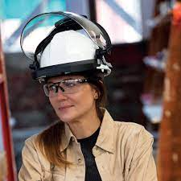
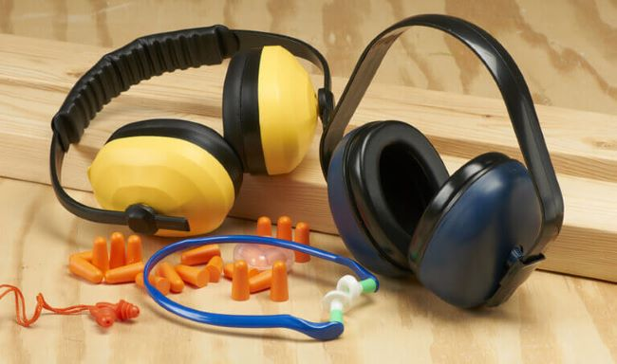
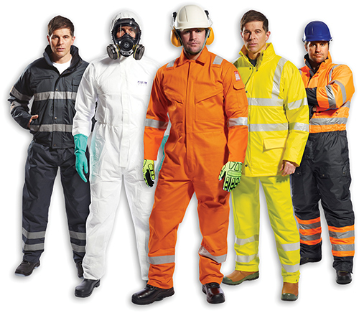
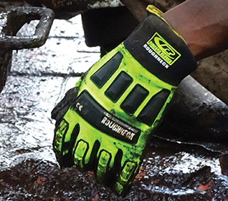
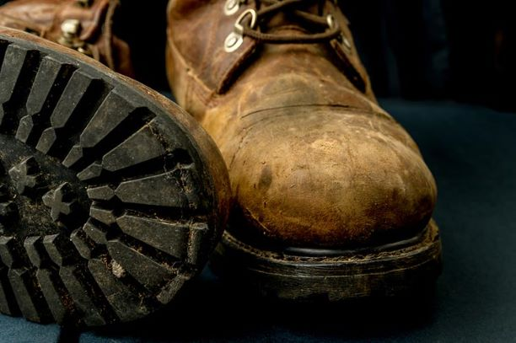
Types of PPE
PPE
Eye and Head
Hearing
Hand
Foot
Body

Slide 44
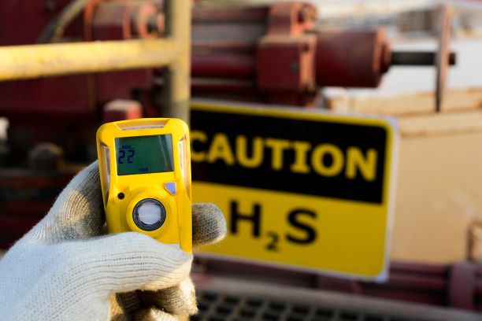
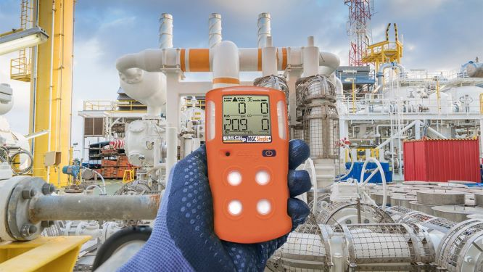
H2S Personal Monitors
PPE
Workers must wear personal monitors to stay aware of H2S concentrations in the air around them as they work.
Any time you enter an area where the concentration of H2S may exceed 10 ppm, you need to wear a personal monitor.

Slide 45
Respiratory Protection
PPE
Respirators are the last line of defense between workers and inhalable hazards.
Respirators must be worn in hazardous atmospheres that exceed
the permissible exposure limit (PEL) or threshold limit value-time weighted average (TLV-TWA)
Immediately dangerous to life or health (IDLH)
Oxygen-deficient environments are considered IDLH

Slide 46
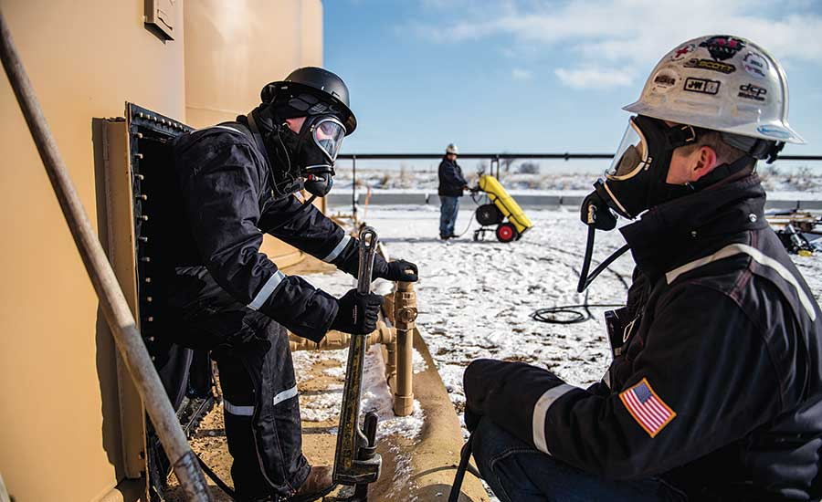
Respiratory Protection
PPE
If the concentration of a chemical is unknown, the atmosphere is considered IDLH and workers are required to wear a
Pressure demand hoseline/airline supplied-air respirator (SAR) with full facepiece and auxiliary self-contained air supply
Positive-pressure demand self-containing breathing apparatus (SCBA)

Slide 47
PPE – INSPECTION AND MAINTENANCE
PPE
Follow manufacturer and company requirements for the maintenance and inspection of each piece of PPE you are expected to use. PPE must be inspected for each use for:
Broken or missing pieces
Cracks, nicks, scratches, or holes
Tears or excessive wear
Brittleness, hardness, and discoloration
Deterioration or damage
Excessive buildup of dirt and other materials

Slide 48
Personal Protective Equipment
PPE
Lesson Review
Discuss company and worker responsibilities regarding PPE
Discuss reasons why workers do not wear PPE
Identify common types of PPE
Discuss maintenance and inspection of PPE

Slide 49
Work Authorisation
IOGP Life-Saving Rule
Bypassing Safety Controls
Life-Saving Rule

Slide 50
IOGP Bypassing Safety Controls
Life-Saving Rule
IOGP Life-Saving Rule
Objectives
Discuss the IOGP Bypassing Safety Controls Life-Saving Rule

Slide 51
IOGP Bypassing Safety Controls
Life-Saving Rule
IOGP Life-Saving Rule
Lesson Review
Discuss company and worker responsibilities regarding PPE
Discuss reasons why workers do not wear PPE
Identify common types of PPE
Discuss maintenance and inspection of PPE

Slide 52
IOGP Bypassing Safety Controls
Life-Saving Rule
PPE
Safety Controls
Energy isolation devices
Relief valves
Seatbelts
Machine guards

Slide 53
IOGP Bypassing Safety Controls
Life-Saving Rule
IOGP Life-Saving Rule
Lesson Review
Discuss the IOGP Bypassing Safety Controls Life-Saving Rule

Slide 54
Module 1 Conclusion
Module 1 Conclusion

