Slide 1
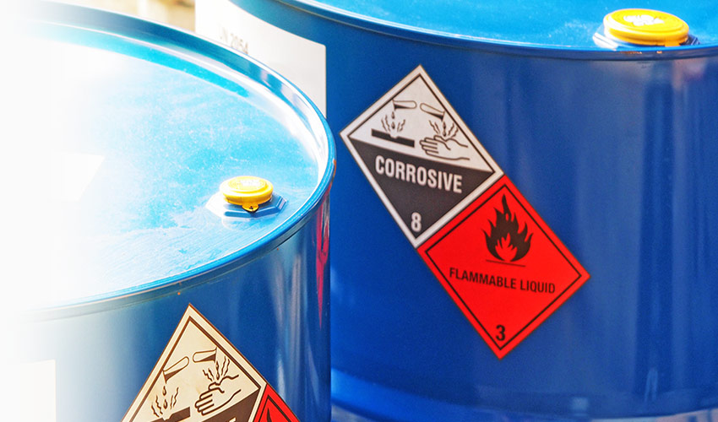
Hazard Communication

Slide 2


Hazard Communication
Hazard Communication
What chemical hazards do you encounter in the workplace?

Slide 3
Hazard Communication
Hazard Communication
Objectives
Discuss the purpose of the Hazard Communication Standard (HCS)
Discuss why keeping an up-to-date chemical inventory is important
Discuss requirements for labels
Discuss how pictograms, signal words, and hazard statements are used to communicate hazards to workers
Demonstrate how to use a safety data sheet (SDS)

Slide 4

Hazard Communication Standard
Hazard Communication
OSHA regulation which protects workers from chemicals they could be exposed to on the job
Aligns with the Globally Harmonized System (GHS)
Workers must be informed of:
  Which hazardous chemicals are at their worksite
  Exposure limits
  Safe handling practices

Slide 5
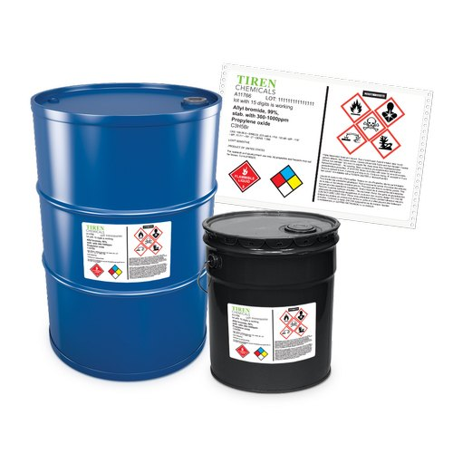
Hazard Communication Standard
Hazard Communication
Chemicals and chemical mixtures are required to be classified according to its hazards
Health hazard category
  These chemicals can harm your body or make you sick
Physical hazard category
  These chemicals can injure you or damage property and the environment
Environmental hazard category
  These are not regulated by OSHA,

Slide 6

Hazard Communication Standard
Hazard Communication
HCS training must cover these main areas
Methods and observations used to determine the presence or release of chemicals
Physical and health hazards of chemicals in the work area
Appropriate work practices, emergency procedures, and PPE to be used
Details of your company’s HCS program

Slide 7

Chemical Inventory
Hazard Communication
Companies are required to keep an up-to-date chemical inventory of all hazardous chemicals at the worksite and inform all workers who have the potential for exposure about the chemical’s hazards.

Slide 8
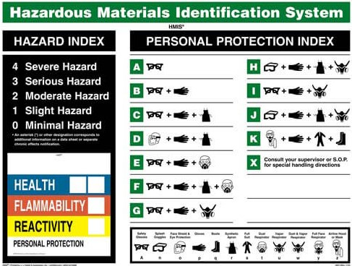
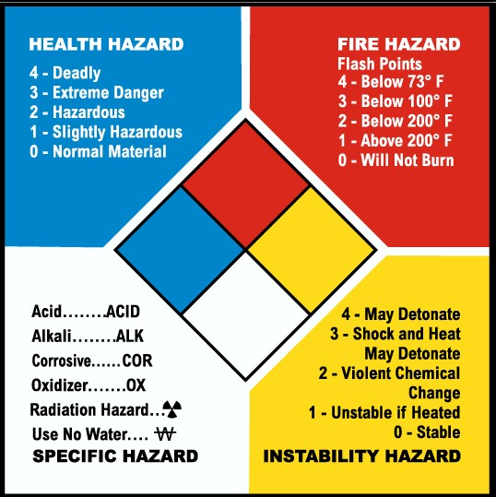
Product Warning Labels
Hazard Communication
Communicate a chemical’s specific hazard
Include colors, shapes, numbers, and terms

Slide 9
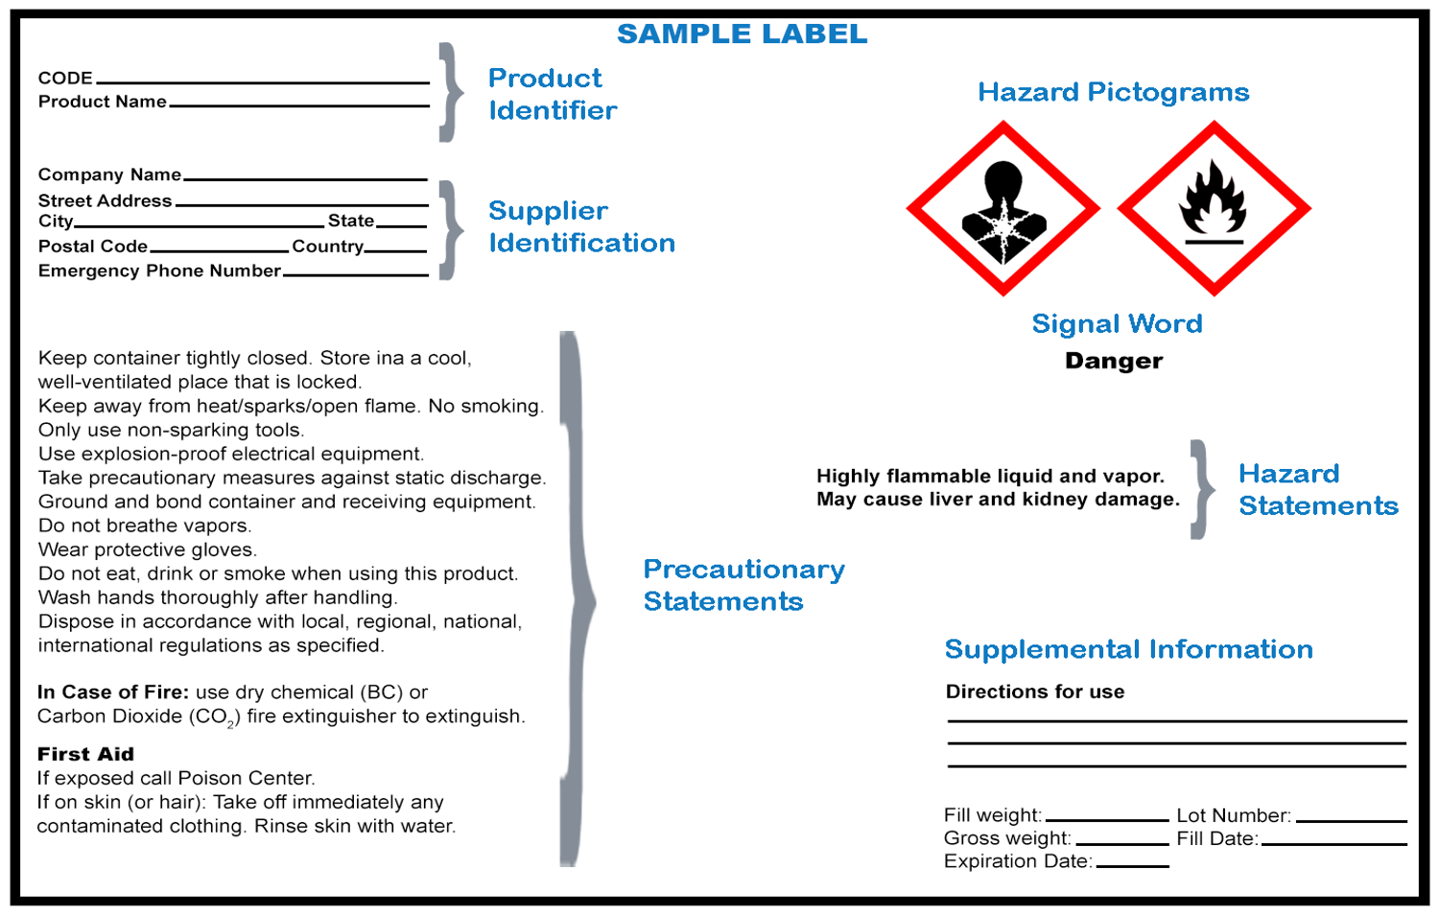
Product Warning Labels
Hazard Communication
GHS labels must have:
Product identifier
Supplier Identification
Precautionary statements
Pictograms
Signal word
Hazard statements
Supplemental information

Slide 10
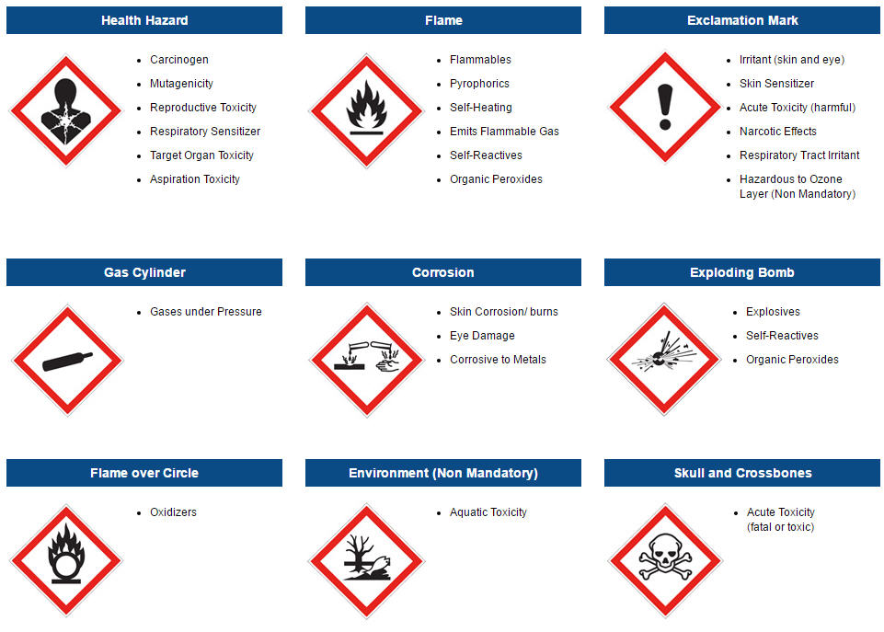
Pictograms
Hazard Communication
HCS requires pictograms on labels to alert users of the chemical hazards.
Each pictogram consists of a symbol on a white background with a red border.

Slide 11
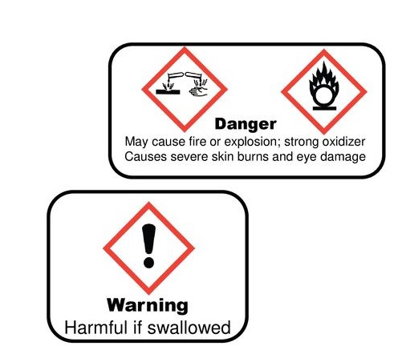
Signal Words
Hazard Communication
Signal words are standardized words that communicate the level of severity of a potential hazard
Only 2 signal words will appear:
Danger – more severe hazard
Warning – less severe hazard
  *Danger and Warning cannot be used at the same time

Slide 12

GHS Label Statements
Hazard Communication
GHS labels have a hazard statement and precautionary statement:
Precautionary statements
  Describe how to reduce the effects of exposure to a hazardous chemical
Hazard statements
  Describe how to reduce the effects of exposure to a hazardous chemical

Slide 13
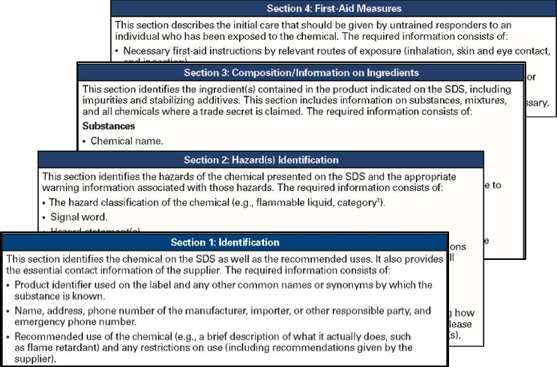
Safety Data Sheets
Hazard Communication
Safety data sheets give detailed information about the hazards of chemicals and how to control those hazards.
Must be available and accessible to workers
Must be located in the area where the chemical is used
Required for all hazardous chemicals used

Slide 14
Safety Data Sheets
Hazard Communication
1. Identification
2. Hazard Identification
3. Composition & Information on Ingredients
4. First Aid
5. Firefighting
6. Accidental Release
7. Handling & Storage
8. Exposure Controls & PPE
9. Physical & Chemical Properties
10. Stability & Reactivity
11. Toxicological Information
12. Ecological Information
13. Disposal Considerations
14. Transport Information
15. Regulatory Information
16. Other Information

Slide 15
GHS Label Statements
Hazard Communication
GHS labels have a hazard statement and precautionary statement:
Precautionary statements
  Describe how to reduce the effects of exposure to a hazardous chemical
Hazard statements
  Describe how to reduce the effects of exposure to a hazardous chemical

Slide 16
Hazard Communication
Hazard Communication
Lesson Review
Discuss the purpose of the Hazard Communication Standard
Discuss why keeping an up-to-date chemical inventory is important
Discuss requirements for labels
Discuss how pictograms, signal words, and hazard statements are used to communicate hazards to workers
Demonstrate how to use a safety data sheet (SDS)

Slide 17

Environmental

Slide 18
Environmental
Environmental
What do you think of when you think of waste?

Slide 19
Environmental
Environmental
Objectives
Identify the different types of waste
Describe ways to minimize waste at the jobsite
Explain the purpose of the Hazardous Waste Operations and Emergency Response (HAZWOPER) Standard.

Slide 20
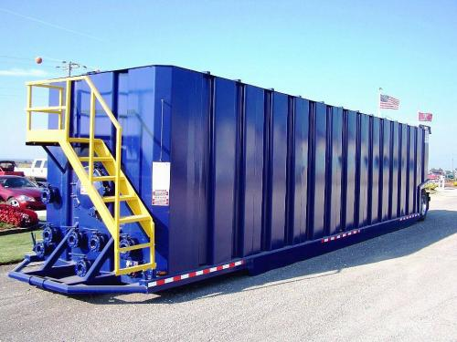
Types of Waste
Environmental
Waste must be properly identified and separated
Types of waste
Solid waste
Exploration and production waste
  Drilling mud, fracturing fluids,used oil, oil filters, antifreeze, produced water
Universal waste
Hazardous waste

Slide 21
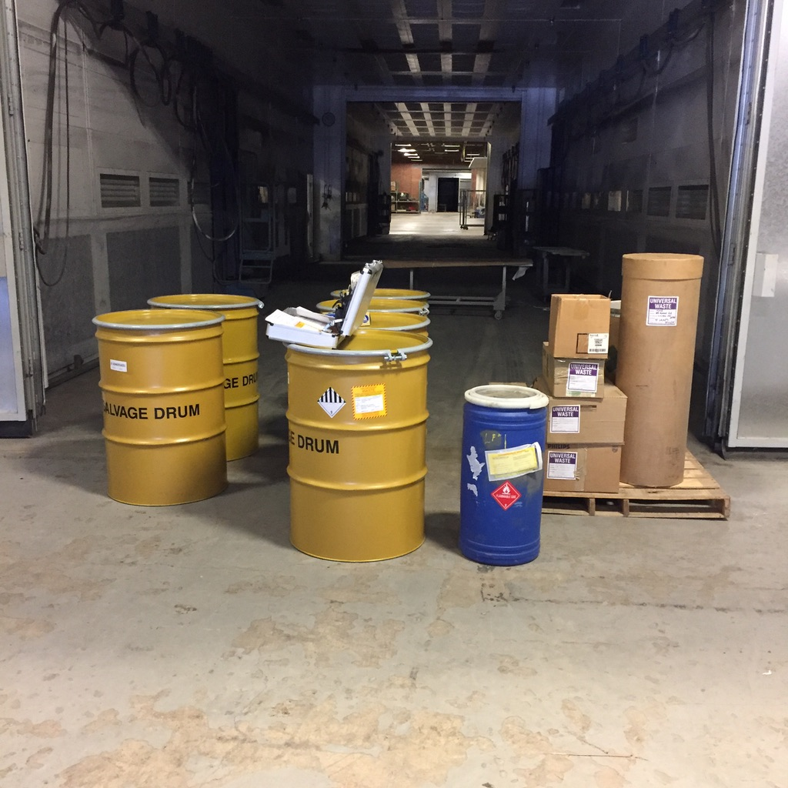
Types of Waste
Environmental
To help minimize waste on the jobsite:
Follow company policies on waste and disposal
Always dispose of general trash and waste
Follow housekeeping policies for trash collection
Respect the environment and take steps to reduce environmental impacts

Slide 22

Hazardous Waste Operations and Emergency Response
Environmental
The HAZWOPER regulation establishes requirements to keep both industry and public safety workers safe when performing hazardous waste cleanup response actions

Slide 23
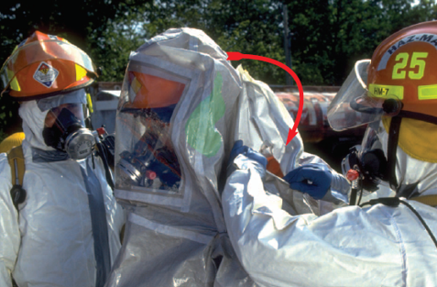
Hazardous Waste Operations and Emergency Response
Environmental
Specific training is required before workers are allowed to engage in hazardous waste operations.
Workers are not allowed to participate in responses to HAZWOPER situations until they have been trained to a level required by their job function and responsibility

Slide 24

First Responder – Awareness Level
Environmental
First Responder - Awareness Level
  individuals who are likely to witness or discover a hazardous substance release and who have been trained to initiate an emergency response notification process
They do nothing beyond notifiying the authorities

Slide 25
Environmental
Environmental
Lesson Review
Identify the different types of waste
Describe ways to minimize waste at the jobsite
Explain the purpose of the Hazardous Waste Operations and Emergency Response (HAZWOPER) Standard.

Slide 26

Industrial Hygiene

Slide 27
Industrial Hygiene
Industrial Hygiene
Objectives
Identify the routes of exposure in which hazards may enter the body
Describe the sources, symptoms of exposure, and control measures for hydrogen sulfide and crystalline silica
Describe biological hazards, how they are transmitted, and the methods to control exposure
Identify common physical hazards and the control measures for preventing worker exposure

Slide 28

Industrial Hygiene
Industrial Hygiene
Industrial hygiene is the science of anticipating, recognizing, assessing, and controlling workplace conditions that could cause worker injuries or illnesses.
Industrial hygienists study hazards and determine when controls are needed and how to use them.

Slide 29




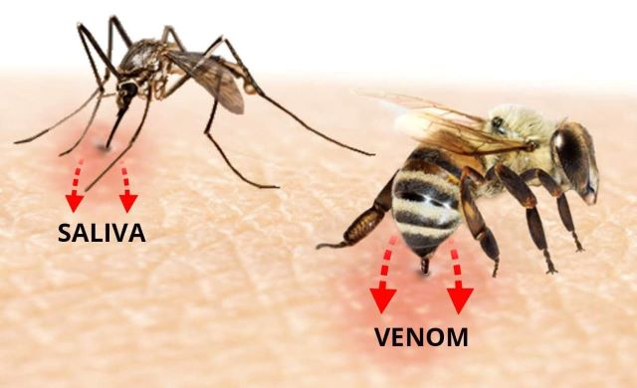
Routes of Exposure
Industrial Hygiene
Inhalation
Ingestion
Skin Absorption
Injection

Slide 30
Workplace Hazards
Industrial Hygiene
Oil and gas operations involve many workplace hazards. It is important that you know how to recognize and assess these hazards.
Chemical
Includes dust, cleaning products, pesticides, asbestos, and benzene
Air Contaminants
Includes particulates, vapors, and gases
Biological
Includes mold, insects, pests, and communicable diseases
Physical
Includes ergonomics, noise, temperature extremes, and radiation

Slide 31
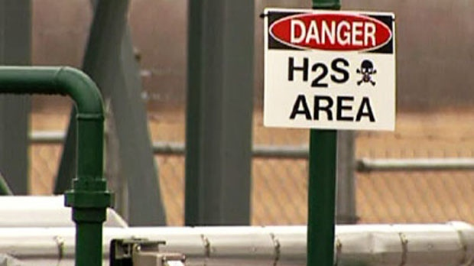
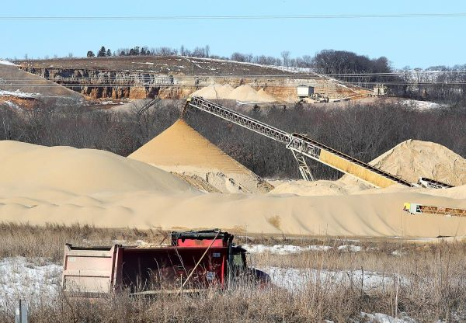
Chemical Hazards
Industrial Hygiene
Chemical substances have the potential to cause harm to life or health. Two of the most common chemical hazards in the oil & gas industry are:
Hydrogen sulfide (H2S)
Silica

Slide 32
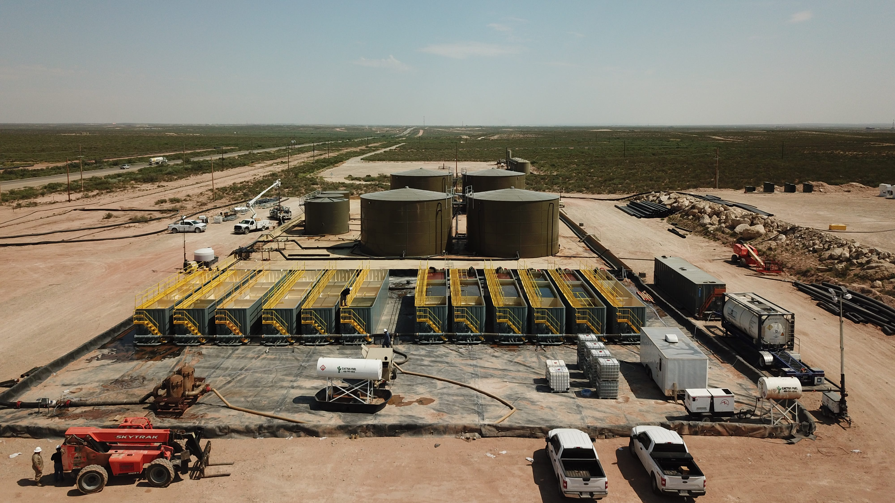
Hydrogen Sulfide
Industrial Hygiene
Can occur naturally or be produced during
industrial processes
Known by many names
Exposure can occur through inhalation or skin contact
Concentrations are measured
in parts per million (ppm)
or percentages
SafeLandUSA 2021 does NOT train workers to work in H2S environments. Workers are required to attend annual training per ANSI Z390.1-2017

Slide 33
Hydrogen Sulfide
Industrial Hygiene
Ten (10) ppm is the industry-accepted exposure level. Check with your company policy for their accepted exposure level.
API Condition 1 – Low Hazard
Less than 10 ppm of H2S present
Assigned a green warning flag

Slide 34
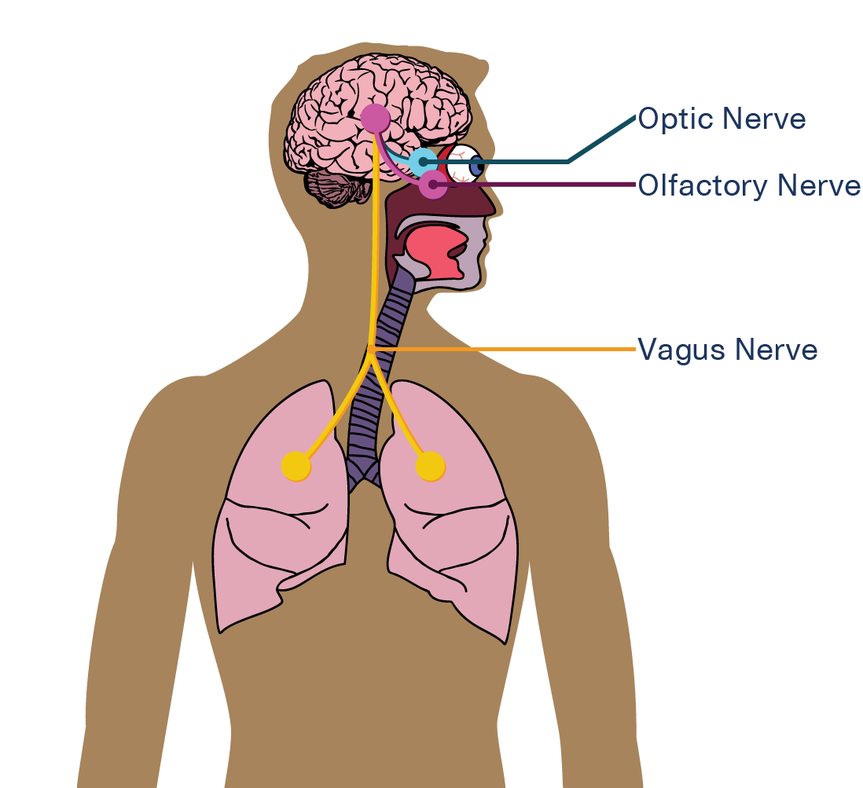
Hydrogen Sulfide- Health Effects
Industrial Hygiene
Affects eyes, nose, brain, lungs, and nerve pathways
  Paralyzes the nerves that interpret smells for your brain
Symptom severity depends on the concentration and length of exposure.
  Acute effects occur after high exposures over a short period of time
  Chronic effects occur after low exposures over a long period of time

Slide 35
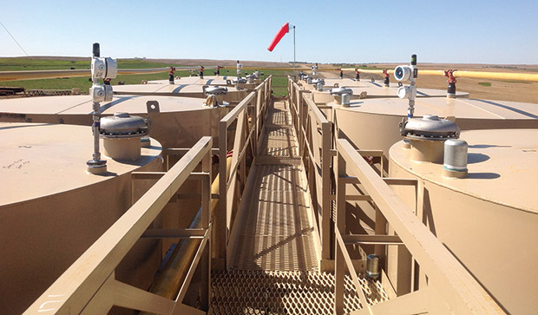
Controlling Hydrogen Sulfide
Industrial Hygiene
Engineering and administrative controls:
Training
Detection and monitoring
Observing wind conditions
Burning and flaring
Work permits
Ventilation
Using the buddy system

Slide 36
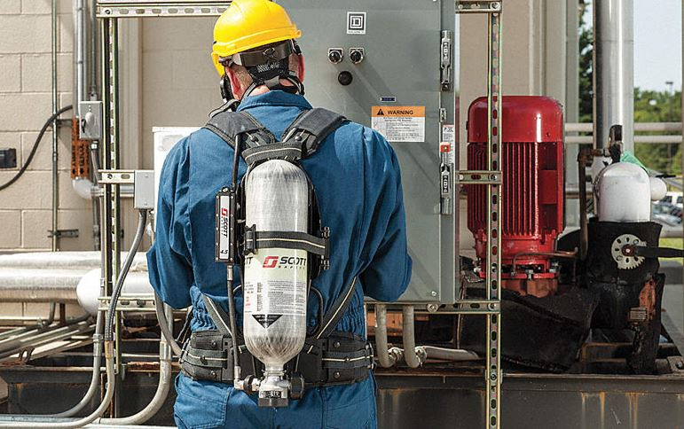
Hydrogen Sulfide PPE
Industrial Hygiene
If you are required to work in an area with an H₂S concentration greater than 10 ppm or your company’s action level, you must wear a supplied air respirator (SAR)

Slide 37

Crystalline Silica
Industrial Hygiene
Found in the earth’s crust
Hazardous when very small, or
respirable, particles are inhaled
Penetrates deep into the lungs and causes disabling and sometimes fatal lung diseases

Slide 38
Biological Hazards
Industrial Hygiene
Engineering and administrative controls:
Training
Detection and monitoring
Observing wind conditions
Burning and flaring
Work permits
Ventilation
Using the buddy system

Slide 39
Controlling Hydrogen Sulfide
Industrial Hygiene
Engineering and administrative controls:
Training
Detection and monitoring
Observing wind conditions
Burning and flaring
Work permits
Ventilation
Using the buddy system

Slide 40
Controlling Hydrogen Sulfide
Industrial Hygiene
Engineering and administrative controls:
Training
Detection and monitoring
Observing wind conditions
Burning and flaring
Work permits
Ventilation
Using the buddy system

Slide 41
Biological Hazards
Environmental
What type of biological hazards do you encounter in the workplace?

Slide 42





Biological Hazards
Industrial Hygiene
Bloodborne Pathogens
Mold, bacteria, fungus
Infectious Disease
Workplace and Personal Hygiene
Back Injuries

Slide 43
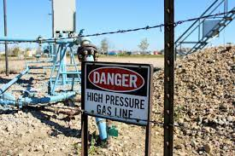


Biological Hazards
Industrial Hygiene
High Pressure
Adverse Weather
Temperature

Slide 44
Industrial Hygiene
Industrial Hygiene
Lesson Review
Identify the routes of exposure in which hazards may enter the body
Describe the sources, symptoms of exposure, and control measures for hydrogen sulfide and crystalline silica
Describe biological hazards, how they are transmitted, and the methods to control exposure
Identify common physical hazards and the control measures for preventing worker exposure

