Slide 1
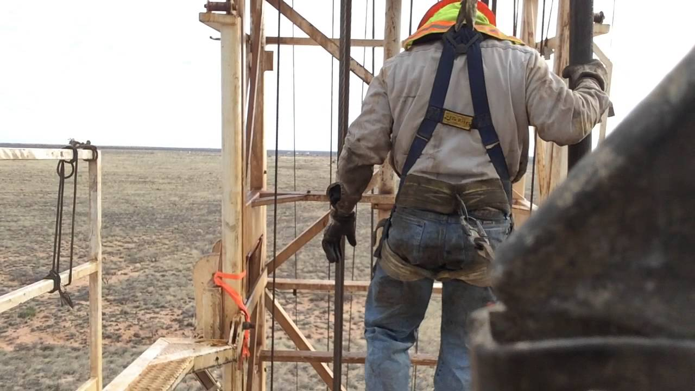
IOGP Working at Heights
Life-Saving Rule
SafeLandUSA™ 2021

Slide 2
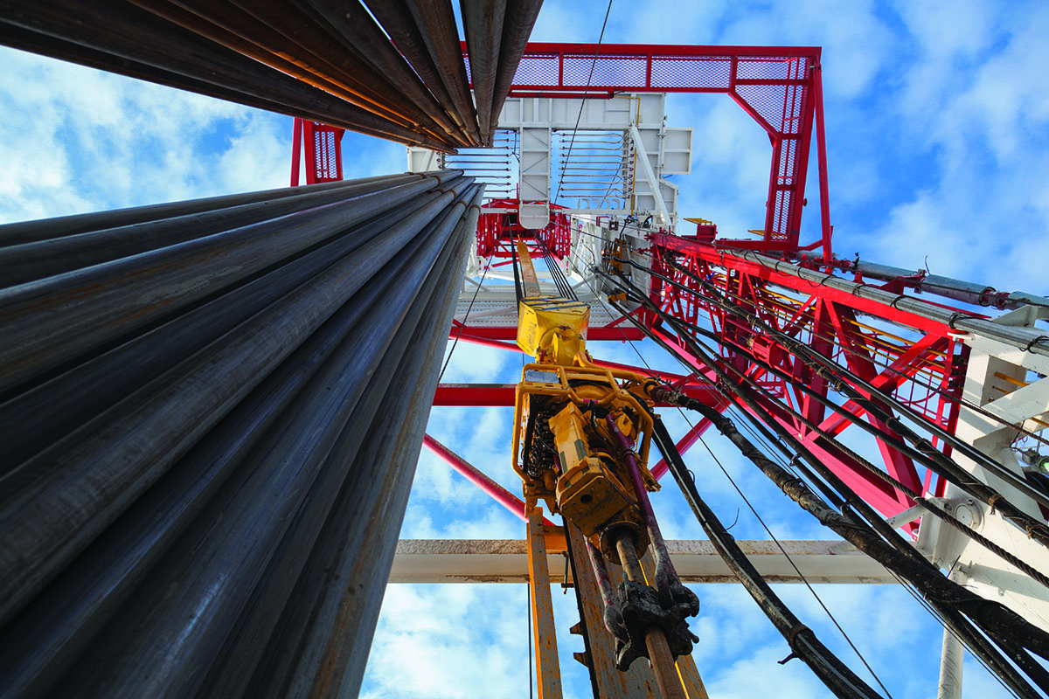
SafeLandUSA™ 2021
ETC’s SafeLandUSA™ 2021 is a one-day safety orientation accredited by SafeLand™ Inc. This orientation provides general safety information to the student and is designed to be used in conjunction with a company’s comprehensive health and safety program.
615 – deaths caused by a fall to a lower level (NSC, 2018)
154 – deaths caused by a fall to the same level (NSC, 2018)
63 – deaths due to falls in oil and gas extraction (CDC/OSHA, 2005-2014)
The SafeLandUSA™ name and logo are used with the approval of SafeLand™ Inc.

Slide 3
IOGP Working at Heights
Life-Saving Rule
IOGP Working at Heights Life-Saving Rule
Objectives
Explain the importance of housekeeping in preventing hazards.
Describe safe work practices for walking working surfaces.
Identify the parts of a personal fall arrest system
Describe general requirements for maintaining and inspecting a personal fall arrest system.
Analyze the IOGP Working at Heights Life-Saving Rule.

Slide 4
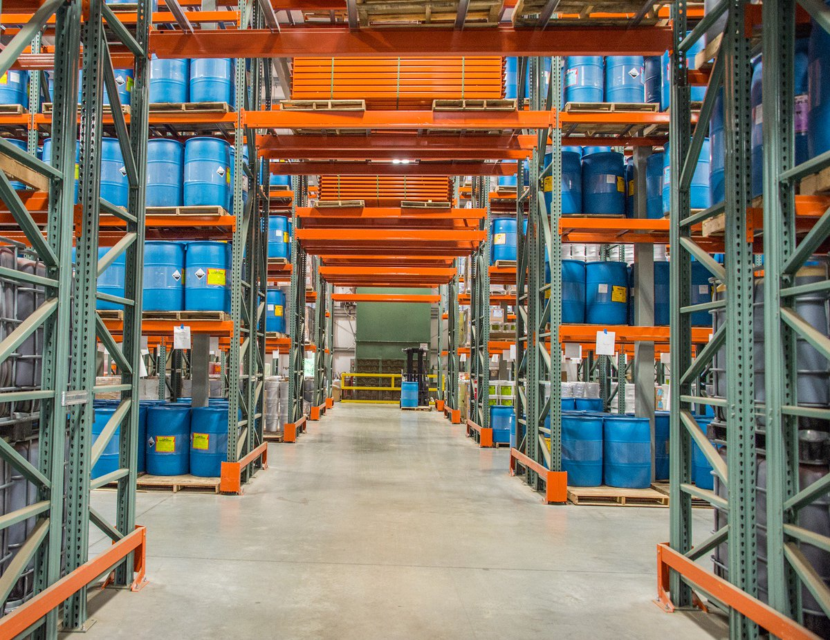
Housekeeping
IOGP Working at Heights Life-Saving Rule
Good housekeeping practices can prevent the accumulation of materials that can cause slips, trips, and falls; fire and explosion hazards; and pest accumulation.

Slide 5
Housekeeping
IOGP Working at Heights Life-Saving Rule
A good housekeeping program identifies and assigns responsibilities for the following:
Clean up during the shift
Day-to-day cleanup
Waste disposal
Removal of unused materials
Inspection to ensure cleanup is complete
Keeping storage areas free from accumulation of materials

Slide 6
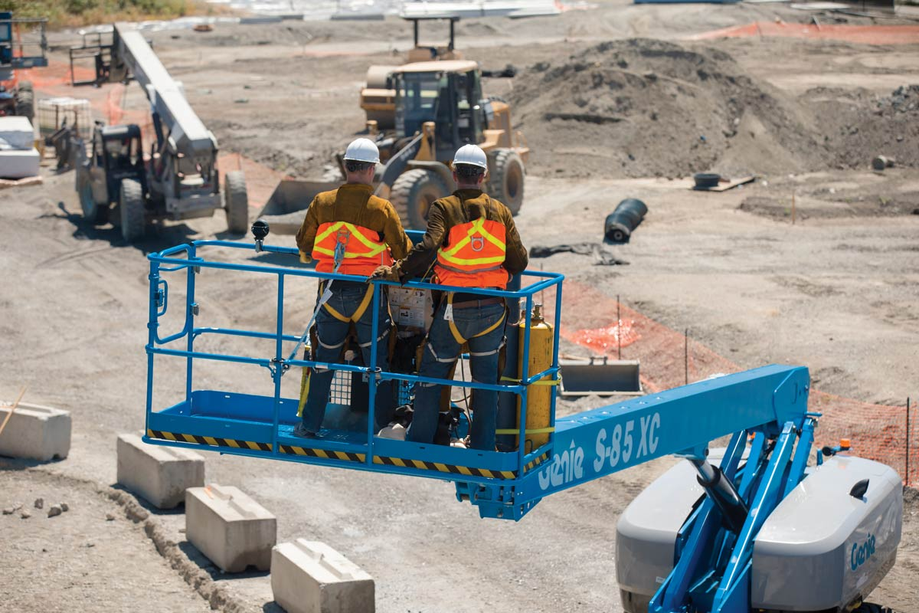
IOGP Working at Heights
Life-Saving Rule
IOGP Working at Heights Life-Saving Rule
Aerial lifts, or man lifts, are on of the most commonly used pieces of equipment to conduct work from elevated locations and are commonly used to replace traditional scaffolding.
A company must authorise a machine operator for an aerial lift to be used. Workers must also be trained in the safe operation of the aerial lift
Aerial lifts, are any vehicle-mounted device (telescoping, articulating, or both) that is used to position workers

Slide 7
Housekeeping
IOGP Working at Heights Life-Saving Rule
A good housekeeping program identifies and assigns responsibilities for the following:
Clean up during the shift
Day-to-day cleanup
Waste disposal
Removal of unused materials
Inspection to ensure cleanup is complete
Keeping storage areas free from accumulation of materials
Many stairway falls result from a loss of balance.
One way workers can maintain their balance is by always keeping one hand on the handrail when using stars
Never store objects or materials on stairs
Avoid carrying loads that block your line of site
Look for wet or slippery surfaces
Do not run/rush while ascending and descending stairs

Slide 8
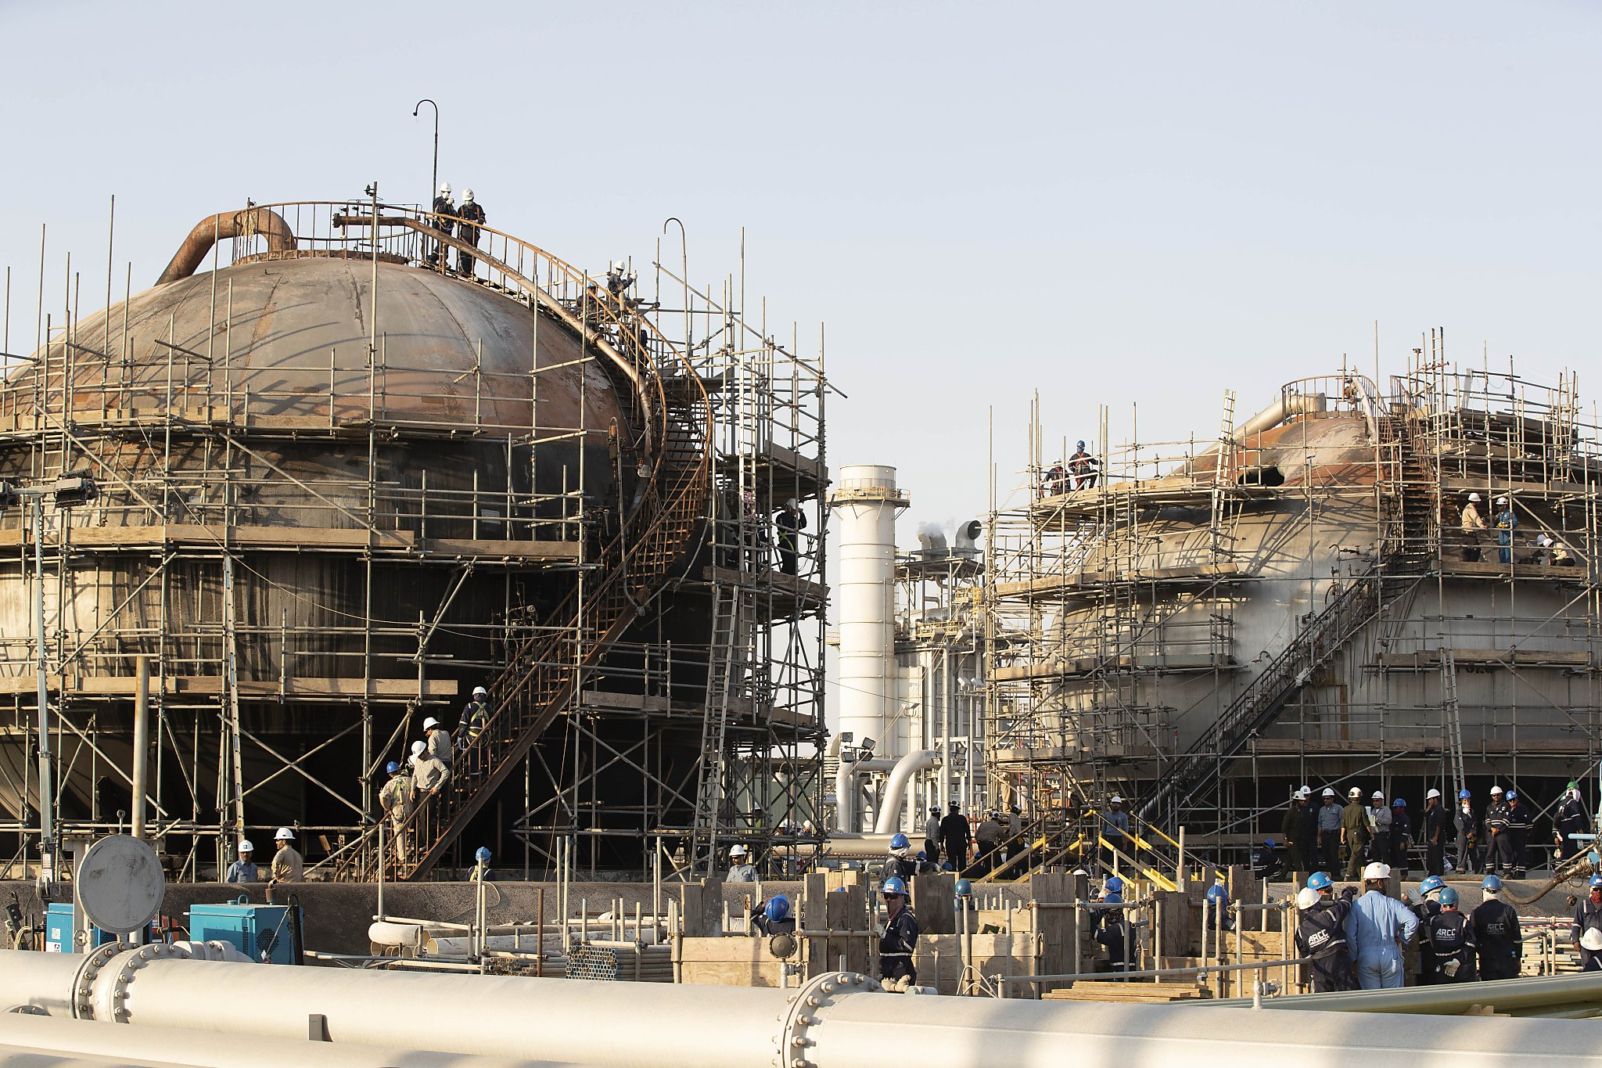
Housekeeping
IOGP Working at Heights Life-Saving Rule
Each worker on a scaffold more than 10 ft above a lower level must be protected from falling to that lower level. The type of fall protection depends on the type of scaffold.
Never exceed the maximum load allowed for the scaffold.
Qualified means one who, by possession of a recognized degree, certificate, or professional standing, or who by extensive knowledge, training, and experience, has successfully demonstrated their ability to solve or resolve problems related to the subject matter, the work or the project.
A competent person is one who is capable of identifying existing and predictable hazards in the surroundings or working conditions that are unsanitary, hazardous, or dangerous to workers. The competent person has the authorisation to take prompt corrective measures to eliminate these hazards or working conditions.
A scaffold must be properly designed by qualified workers.
Scaffolding can only be built, moved, altered, and dismantled under the supervision and direction of a competent person.

Slide 9
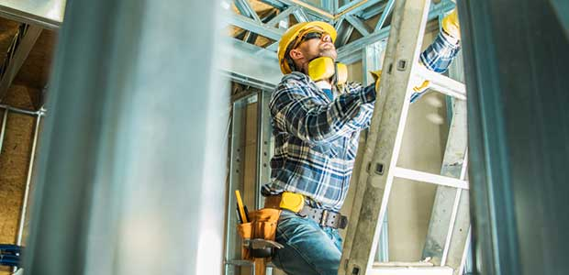
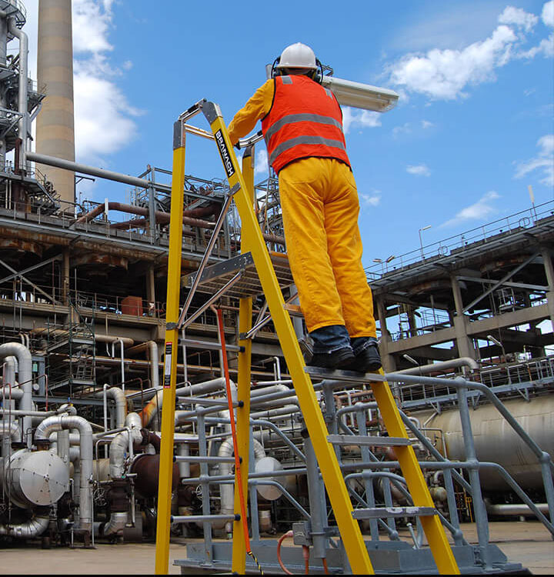
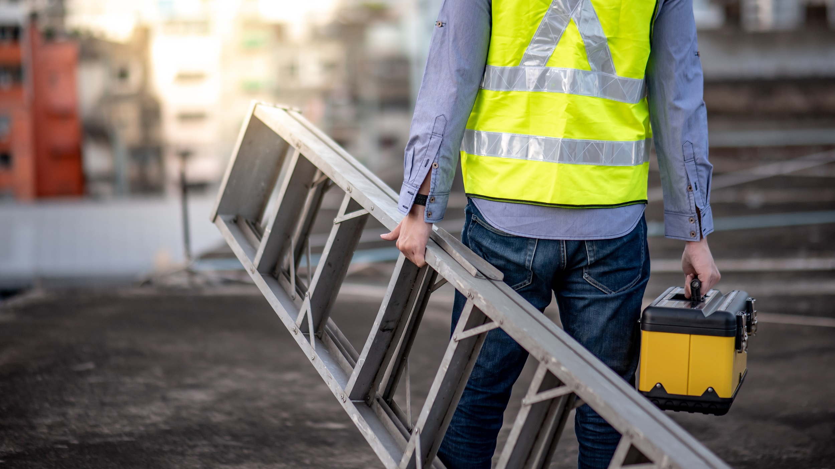
Safety Culture
If you will be using an open extension ladder:
The top of the ladder must extend 3 ft past an upper level when used to access a higher working platform
Maintain a 4:1 ratio from the base to the top support
For every 4 ft you extend the ladder vertically, move the base 1 foot out
When using a ladder, you should:
Maintain three points of contact with the ladder
Get authorisation to do elevated work
Clear the footing area and remove unnecessary materials from under or near the ladder
Place the ladder on a hard, flat, and clean surface
Fully open the ladder’s legs
Only carry the necessary tools in pockets or tool belt, secured properly
Attach a hand line and lift items once you are on a stable surface.

Slide 10
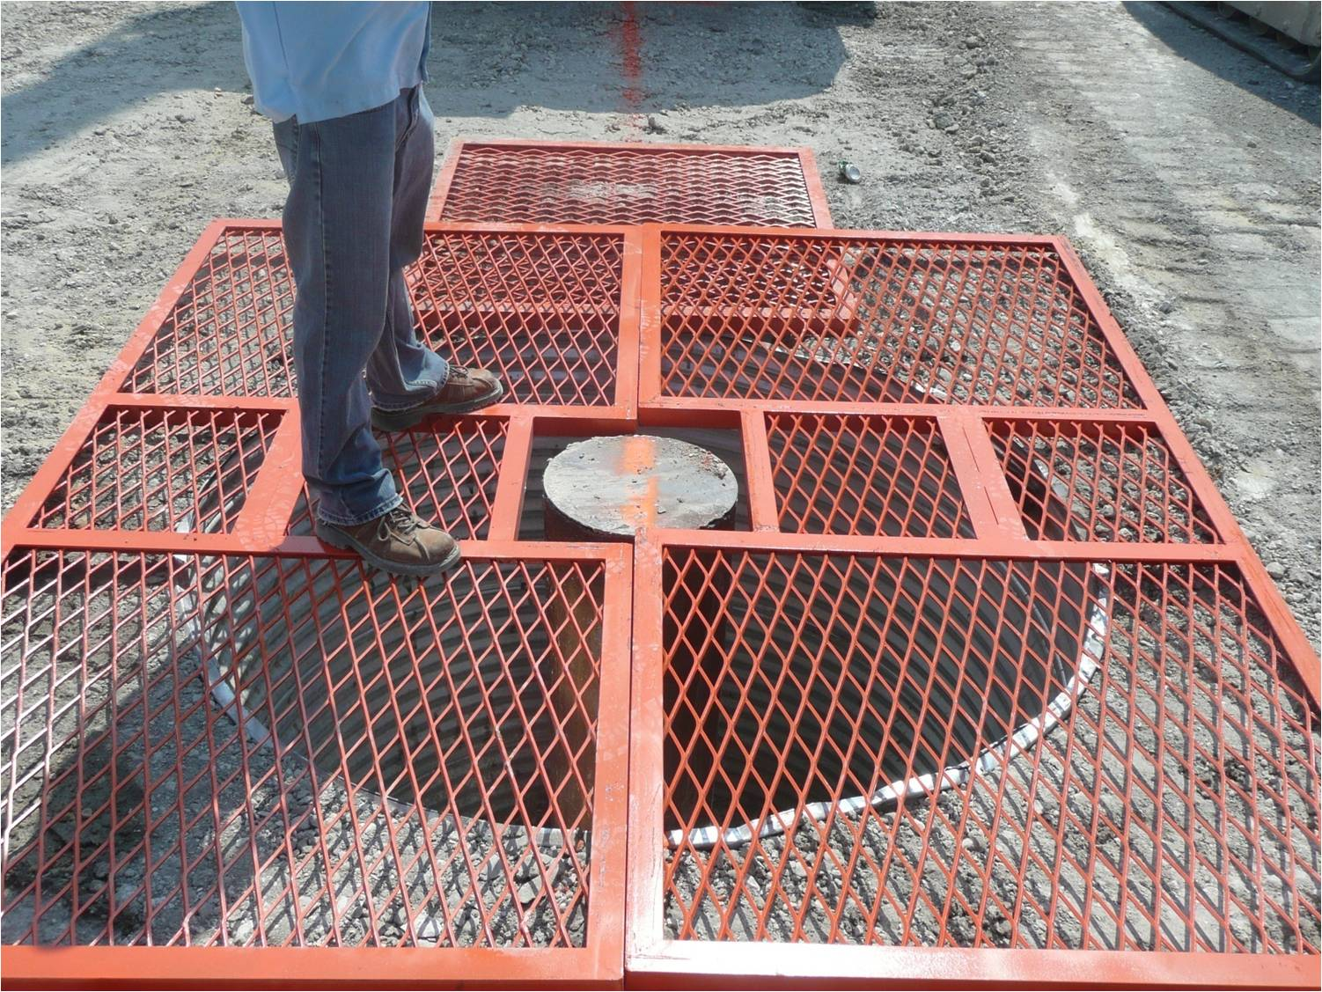
Safety Culture
IOGP Working at Heights Life-Saving Rule
Workers must be protected from falling through any hole that is 4 ft or more above a lower level.
Protection methods include, but are not limited to:
Covers
Guardrail systems
Travel restraint systems
Personal fall arrest systems

Slide 11
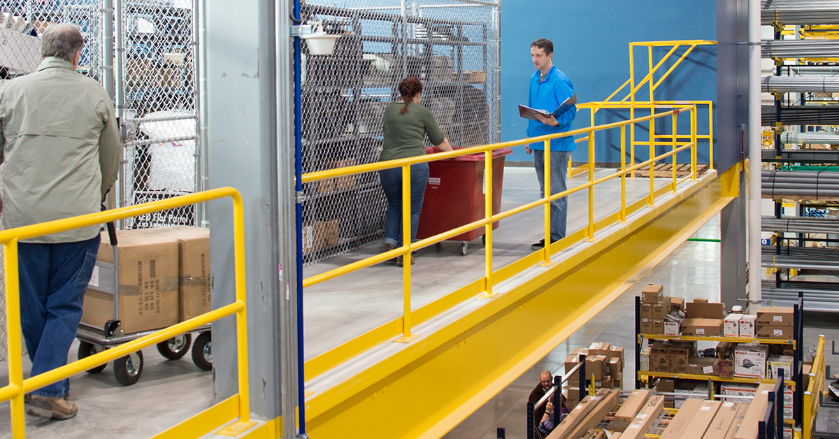
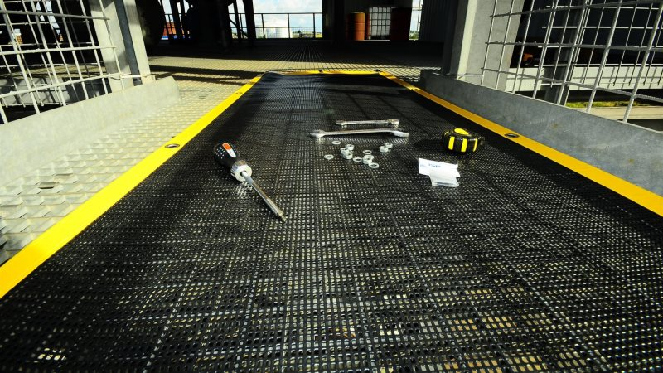
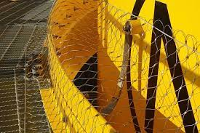
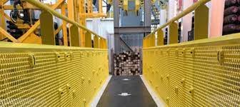
Safety Culture
IOGP Working at Heights Life-Saving Rule
Dropped object control methods include:
Guardrails with toe boards or screening
Covers on open grating
Barricades and overhead protective structures
Tool lanyards and tethers
Administrative controls include:
Proper load securement and hoisting practices
Housekeeping practices
Proper storage and stacking of materials
Falling and being struck by a dropped object are among the top causes of workplace injuries and fatalities:
(The Bureau of Labor Statistics) BLS reported that being struck by falling objects or equipment resulted in 45,940 injuries in 2017 (5.2% of all workplace injuries).

Slide 12
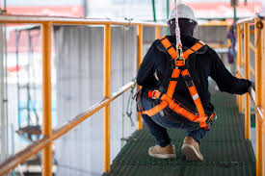
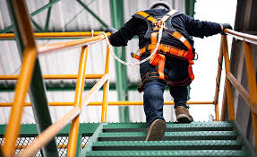
Fall Protection
IOGP Working at Heights Life-Saving Rule
Required when workers are:
Less than 4 ft. above dangerous equipment
Unless covered or guarded
4 ft. above lower levels in general industry
6 ft. above lower levels in construction industry

Slide 13
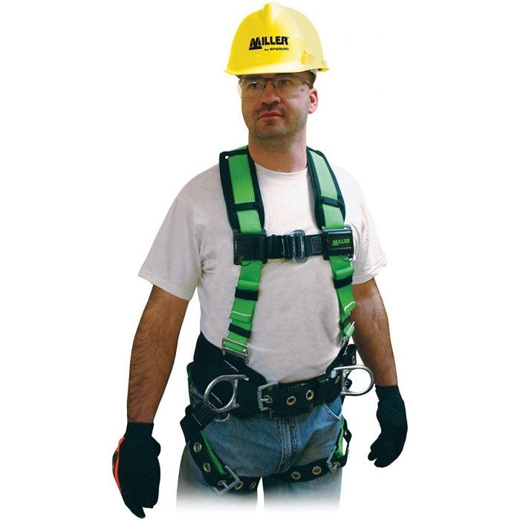
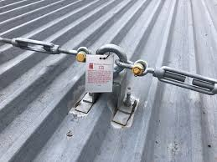
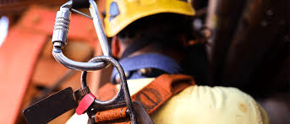
Personal Fall Arrest System
IOGP Working at Heights Life-Saving Rule
ABC’s of personal fall arrest systems
Full Body Harness- made up of straps that secure a worker so the force of a fall is distributed evenly over their shoulders, chest, waist, pelvis, and thighs
Anchor Point – a secure attachment point for equipment such as lifelines, lanyards, deceleration devices, and rope descent sytems
Connecting Device-
Can include a lanyard, deceleration device, lifeline, or an acceptable combination of these
SRLs should be attached to the D-ring in the middle of a worker’s back

Slide 14
Personal Fall Arrest System
IOGP Working at Heights Life-Saving Rule
All parts must be capable of supporting a 5,000-pound load.
Parts must only be used for worker fall protection.
Workers must be trained on the use of the equipment.
PFAS must be inspected before initial use during each workshift.
Damaged, modified, or defective equipment must be removed from service.
PFAS or components subjected to a fall must be removed from service.

Slide 15
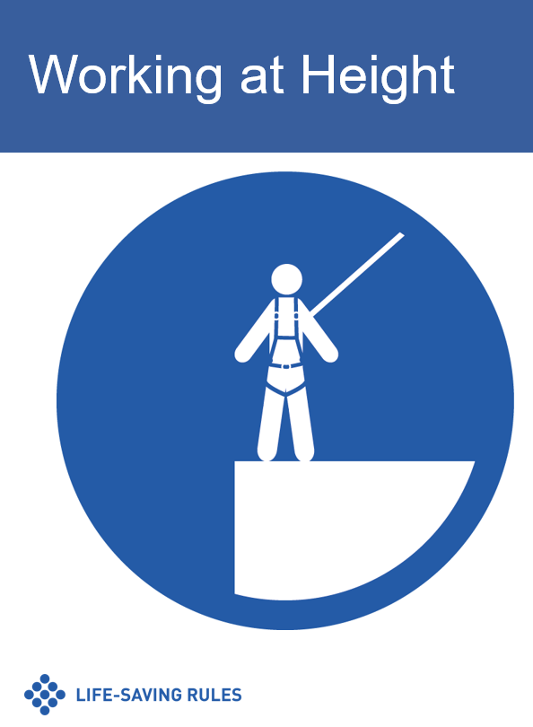
Personal Fall Arrest System
IOGP Working at Heights Life-Saving Rule
All parts must be capable of supporting a 5,000-pound load.
Parts must only be used for worker fall protection.
Workers must be trained on the use of the equipment.
PFAS must be inspected before initial use during each workshift.
Damaged, modified, or defective equipment must be removed from service.
PFAS or components subjected to a fall must be removed from service.

Slide 16
IOGP Working at Heights
Life-Saving Rule
IOGP Working at Heights Life-Saving Rule
Lesson Review
Explain the importance of housekeeping in preventing hazards.
Describe safe work practices for walking working surfaces.
Identify the parts of a personal fall arrest system
Describe general requirements for maintaining and inspecting a personal fall arrest system.
Analyze the IOGP Working at Heights Life-Saving Rule.

Slide 17
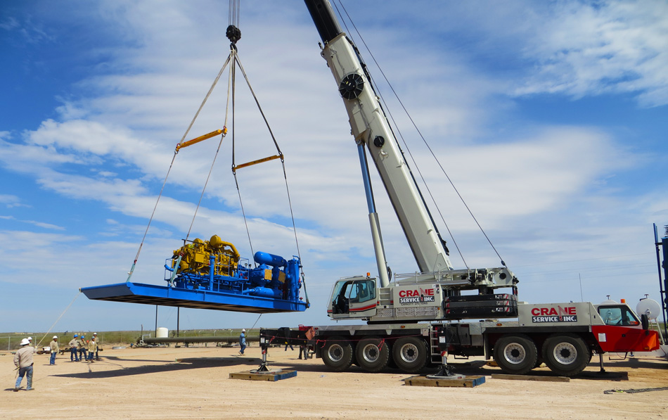
IOGP Safe Mechanical Lifting Life-Saving Rule
SafeLandUSA™ 2021

Slide 18
IOGP Safe Mechanical Lifting
Life-Saving Rule
IOGP Safe Mechanical Lifting Life-Saving Rule
Objectives
Describe general requirements for lifting equipment.
Describe training requirements for operating lifting equipment.
Explain the purpose of a lift plan.
Describe safe work practices for mechanical lifting.
Analyze the IOGP Safe Mechanical Lifting Life-Saving Rule.

Slide 19
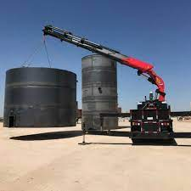
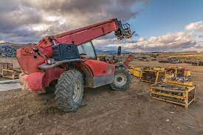
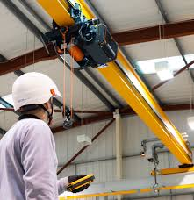
Lifting Equipment
IOGP Safe Mechanical Lifting Life-Saving Rule
Operators
Operate equipment safely
Be fully trained, qualified (certified), and authorized
Wear seatbelts
Must not allow anyone to ride on equipment
Equipment
Be fit for intended purpose
Maintained and supported by an equipment register
Visually examined before and after use

Slide 20
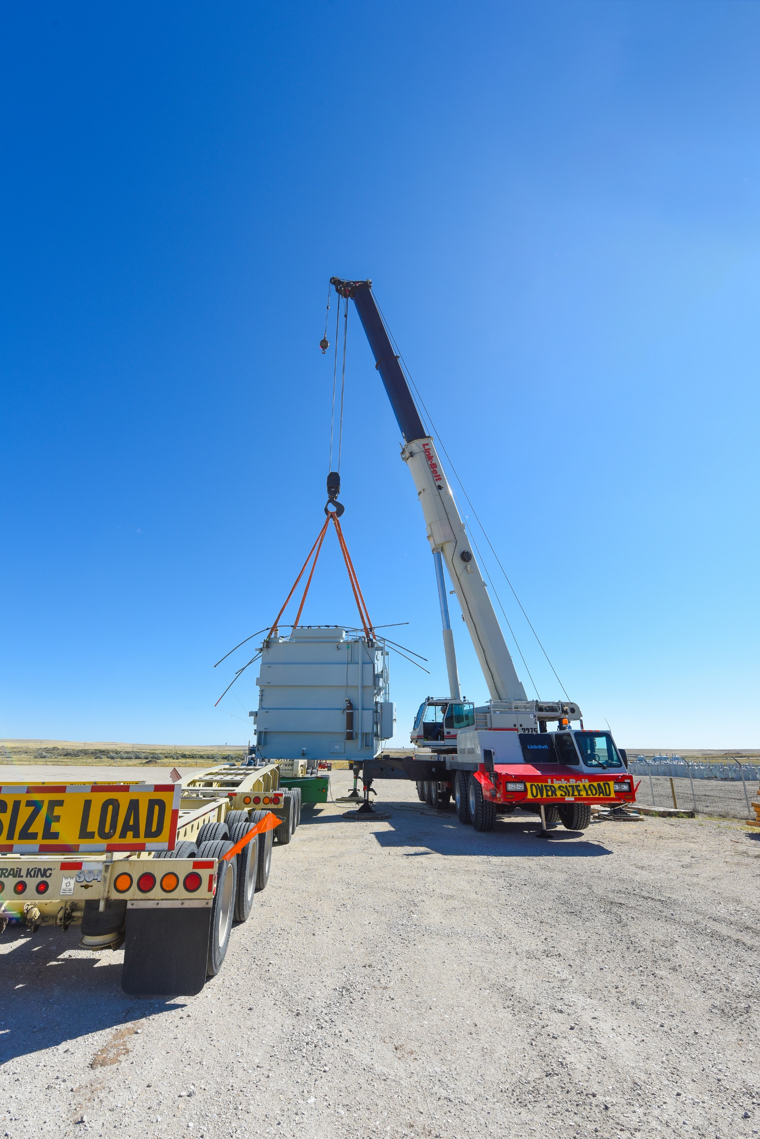
Lift Plan
IOGP Safe Mechanical Lifting Life-Saving Rule
A lift plan should be required for every critical lift.
2-crane lifts
When lift exceeds 75% of the crane’s lifting capacity
When required by the company
Lift should be stopped if it deviates from the plan.
A person is designated as Person in Charge.
All workers have individual responsibilities defined.

Slide 21
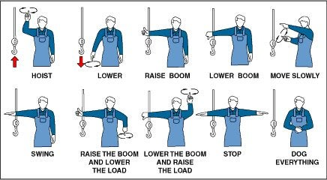
Communication
IOGP Safe Mechanical Lifting Life-Saving Rule
Use hand signals when verbal communication with the equipment operator is not possible.
Operators will designate a qualified signal worker, especially if they do not have full view of the lifting operation.

Slide 22
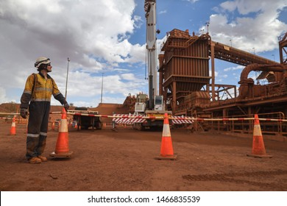
Barrier and Exclusion Zones
IOGP Safe Mechanical Lifting Life-Saving Rule
When working within exclusion zones:
Be aware of your surroundings.
Wear high visibility clothing.
Agree on communication methods before starting work.
Erect and maintain barriers.
Inform operators if outside of the operator’s view.
Keep unauthorized people out of the work area.

Slide 23
Safe Work Practices
IOGP Safe Mechanical Lifting Life-Saving Rule
Stay out from under loads.
Keep your hands, feet, and body clear of pinch points.
Ensure equipment is free to be lifted before moving it.
Do not exceed capacities of lifting equipment.
Maintain safe and sufficient clearances.
Follow clearance warning signs.
Protect yourself with the proper PPE.
Maintain situational awareness.
Use taglines properly.
Stay out of the line of fire of moving loads.

Slide 24
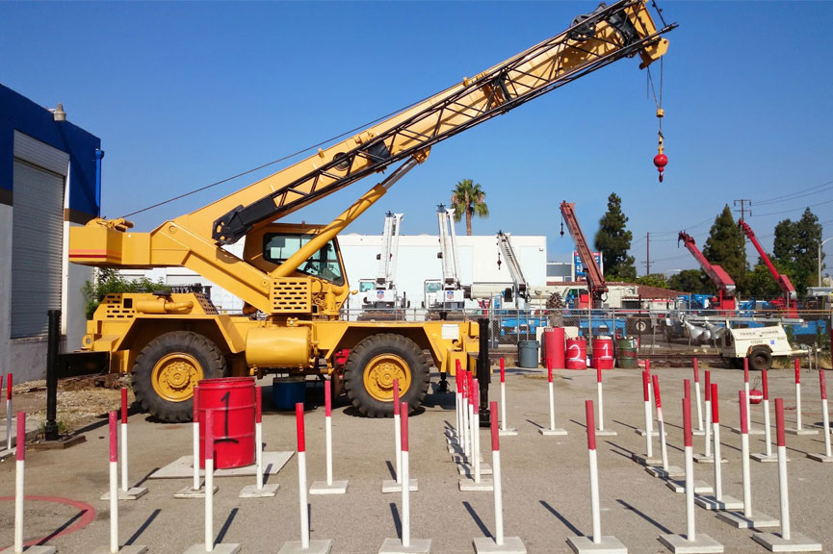
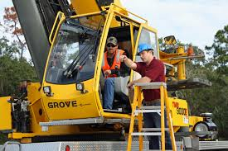
Training
IOGP Safe Mechanical Lifting Life-Saving Rule
Forklift and crane operators are required to successfully complete the following before they can operate the equipment in the field:
Classroom training
Hands-on training
An evaluation

Slide 25
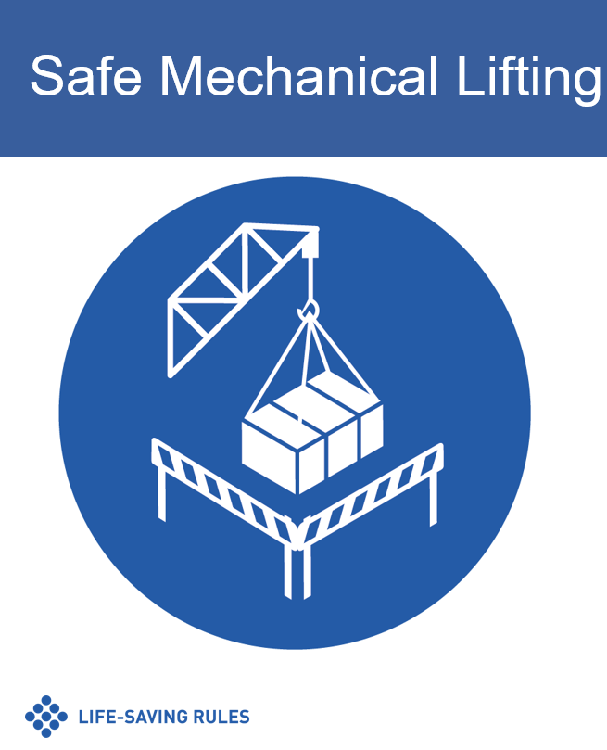
Safety Culture
IOGP Safe Mechanical Lifting Life-Saving Rule
What does safety culture mean to you?

Slide 26
IOGP Safe Mechanical Lifting
Life-Saving Rule
IOGP Safe Mechanical Lifting Life-Saving Rule
Lesson Review
Describe general requirements for lifting equipment.
Describe training requirements for operating lifting equipment.
Explain the purpose of a lift plan.
Describe safe work practices for mechanical lifting.
Analyze the IOGP Safe Mechanical Lifting Life-Saving Rule.

Slide 27
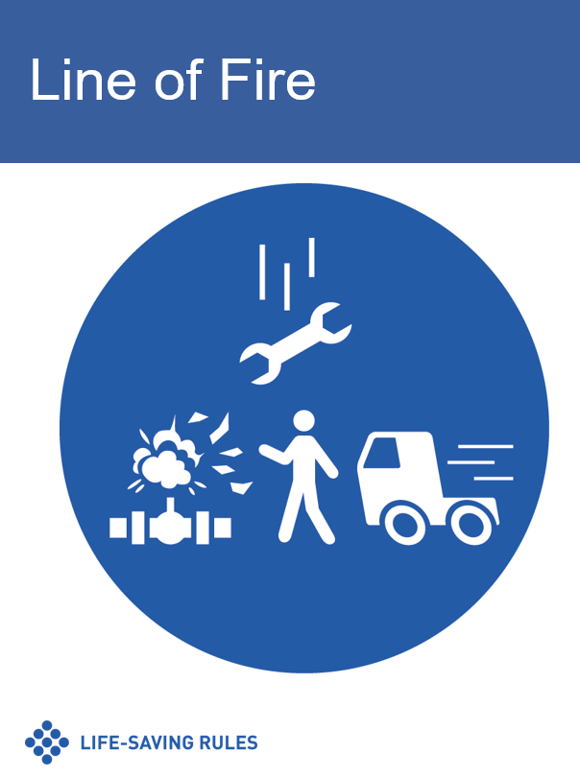
IOGP Line of Fire
Life-Saving Rule
IOGP Line of Fire Life-Saving Rule

Slide 28
IOGP Safe Mechanical Lifting
Life-Saving Rule
IOGP Driving Life-Saving Rule

Slide 29
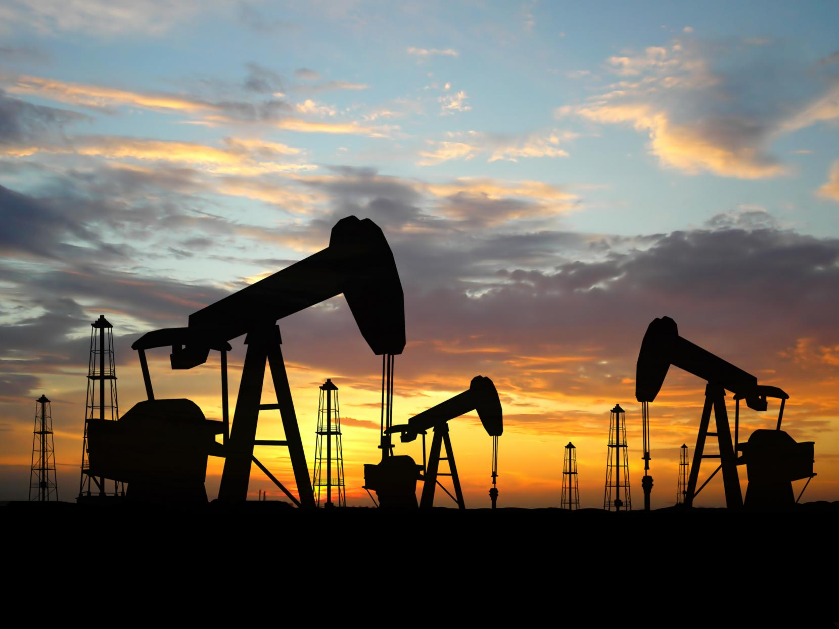
Module 4 Conclusion
SafeLandUSA™ 2021

